Slide 1

Lecture 8
Polymorphism

Slide 2
Polymorphism in Java
Polymorphism in Java is a concept by which we can perform a single action in different ways. Polymorphism is derived from 2 Greek words: poly and morphs. The word "poly" means many and "morphs" means forms. So polymorphism means many forms.
There are two types of polymorphism in Java: compile-time polymorphism and runtime polymorphism. We can perform polymorphism in java by method overloading and method overriding.
If you overload a static method in Java, it is the example of compile time polymorphism.

Slide 3
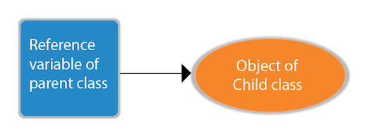
Runtime Polymorphism in Java
Runtime polymorphism or Dynamic Method Dispatch is a process in which a call to an overridden method is resolved at runtime rather than compile-time.
Upcasting
If the reference variable of Parent class refers to the object of Child class, it is known as upcasting. For example:

Slide 4
class A{}
class B extends A{}
A a=new B();//upcasting

Slide 5
Example of Java Runtime Polymorphism
class Bike{
void run(){System.out.println("running");}
}
class Splendor extends Bike{
void run(){System.out.println("running safely with 60km");}
public static void main(String args[]){
Bike b = new Splendor();//upcasting
b.run();
}
}

Slide 6
class Bike{
int a=10;
void run(){System.out.println("running");}
}
class Splendor extends Bike
{
int a=100;
void run(){System.out.println("running safely with 60km");}
public static void main(String args[]){
Bike b = new Splendor();//upcasting
System.out.println(b.a);
}
}

Slide 7
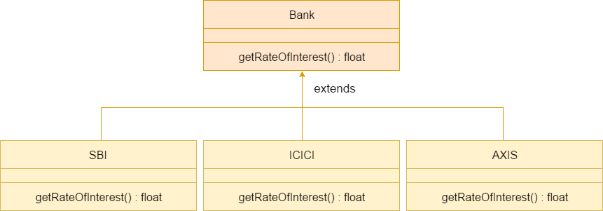
Java Runtime Polymorphism Example: Bank
For example, SBI, ICICI, and AXIS banks are providing 8.4%, 7.3%, and 9.7% rate of interest.

Slide 8
class Bank{
float getRateOfInterest(){return 0;}
}
class SBI extends Bank{
float getRateOfInterest(){return 8.4f;}
}
class ICICI extends Bank{
float getRateOfInterest(){return 7.3f;}
}
class AXIS extends Bank{
float getRateOfInterest(){return 9.7f;}
}
class TestPolymorphism{
public static void main(String args[]){
Bank b;
b=new SBI();
System.out.println("SBI Rate of Interest: "+b.getRateOfInterest());
b=new ICICI();
System.out.println("ICICI Rate of Interest: "+b.getRateOfInterest());
b=new AXIS();
System.out.println("AXIS Rate of Interest: "+b.getRateOfInterest());
}
}

Slide 9
abstract class Bike{
abstract void run();
public void f()
{
System.out.println("ashosh");
}
}
class Honda4 extends Bike{
public void f()
{
System.out.println("qqqqqqqqqqqq");
}
void run(){System.out.println("running safely");}
public static void main(String args[]){
Bike obj = new Honda4();
obj.f();
}
}

Slide 10
Java Runtime Polymorphism with Data Member
class Bike{
int speedlimit=90;
}
class Honda3 extends Bike{
int speedlimit=150;
public static void main(String args[]){
Bike obj=new Honda3();
System.out.println(obj.speedlimit);
}

Slide 11
Java Runtime Polymorphism with Multilevel Inheritance
class Animal{
void eat(){System.out.println("eating");}
}
class Dog extends Animal{
void eat(){System.out.println("eating fruits");}
}
class BabyDog extends Dog{
void eat(){System.out.println("drinking milk");}
public static void main(String args[]){
Animal a1,a2,a3;
a1=new Animal();
a2=new Dog();
a3=new BabyDog();
a1.eat();
a2.eat();
a3.eat();
}
}

Slide 12
class Animal{
void eat(){System.out.println("animal is eating...");}
}
class Dog extends Animal{
void eat(){System.out.println("dog is eating...");}
}
class BabyDog1 extends Dog{
public static void main(String args[]){
Animal a=new BabyDog1();
a.eat();
}}

Slide 13
Method Overloading in Java
If a class has multiple methods having same name but different in parameters, it is known as Method Overloading.
There are two ways to overload the method in java
By changing number of arguments
By changing the data type

Slide 14
1) Method Overloading: changing no. of arguments
class Adder{
static int add(int a,int b){return a+b;}
static int add(int a,int b,int c){return a+b+c;}
}
class TestOverloading1{
public static void main(String[] args){
System.out.println(Adder.add(11,11));
System.out.println(Adder.add(11,11,11));
}}

Slide 15
2) Method Overloading: changing data type of arguments
class Adder{
static int add(int a, int b){return a+b;}
static double add(double a, double b){return a+b;}
}
class TestOverloading2{
public static void main(String[] args){
System.out.println(Adder.add(11,11));
System.out.println(Adder.add(12.3,12.6));
}}

Slide 16
Why Method Overloading is not possible by changing the return type of method only?
In java, method overloading is not possible by changing the return type of the method only because of ambiguity. Let's see how ambiguity may occur:
class Adder{
static int add(int a,int b){return a+b;}
static double add(int a,int b){return a+b;}
}
class TestOverloading3{
public static void main(String[] args){
System.out.println(Adder.add(11,11));//ambiguity
}}

Slide 17
Can we overload java main() method?
class TestOverloading4{
public static void main(String[] args){System.out.println("main with String[]");}
public static void main(String args){System.out.println("main with String");}
public static void main(){System.out.println("main without args");}
}

Slide 18
Method Overloading and Type Promotion
class OverloadingCalculation1{
void sum(int a,long b){System.out.println(a+b);}
void sum(int a,int b,int c){System.out.println(a+b+c);}
public static void main(String args[]){
OverloadingCalculation1 obj=new OverloadingCalculation1();
obj.sum(20,20);//now second int literal will be promoted to long
obj.sum(20,20,20);
}
}

Slide 19
Example of Method Overloading with Type Promotion if matching found
class OverloadingCalculation2{
void sum(int a,int b){System.out.println("int arg method invoked");}
void sum(long a,long b){System.out.println("long arg method invoked");}
public static void main(String args[]){
OverloadingCalculation2 obj=new OverloadingCalculation2();
obj.sum(20,20);//now int arg sum() method gets invoked
}
}

Slide 20
class OverloadingCalculation3{
void sum(int a,long b){System.out.println("a method invoked");}
void sum(long a,int b){System.out.println("b method invoked");}
public static void main(String args[]){
OverloadingCalculation3 obj=new OverloadingCalculation3();
obj.sum(20,20);//now ambiguity
}
}

Slide 21
Method Overriding in Java
Method overriding is an example of runtime polymorphism.

